Slide 1
Server Side Technologies by:
Michael Wakahe,
2010

Slide 2
Definition of Server
Client-Server model is where client modules make requests for information to a server module, the server processes and sends back response
Server usually more capable than clients, servers usually fewer in number than clients

Slide 3
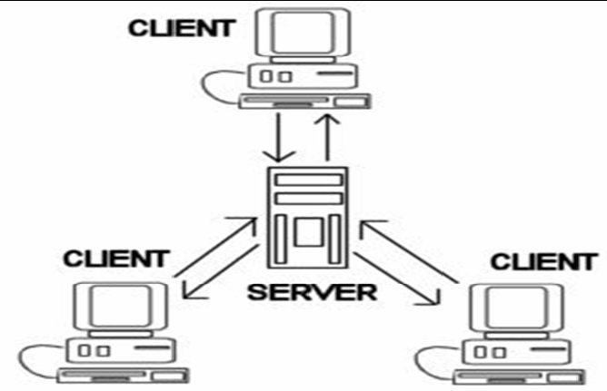
Definition of Server – Client-Server

Slide 4
Definition of Server
Other model: Peer-to-peer
In Peer-to-peer, participants act both as clients and servers
Participants are equally capable, have equal privileges

Slide 5
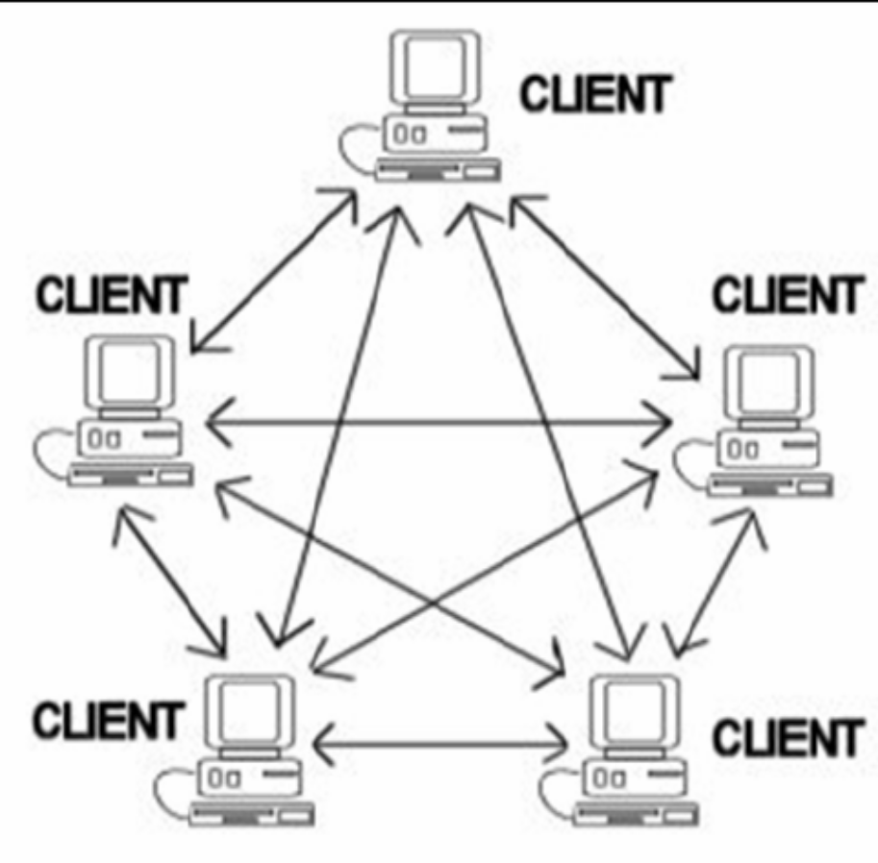
Definition of Server – Peer-to-peer

Slide 6
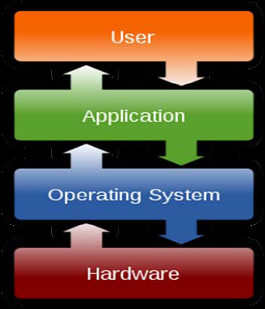
Definition of Server
What exactly is a server?
  Hardware
  Software
  A combination

Slide 7
Server Hardware
3 main categories
Tower, Rack Mount, Blade

Slide 8
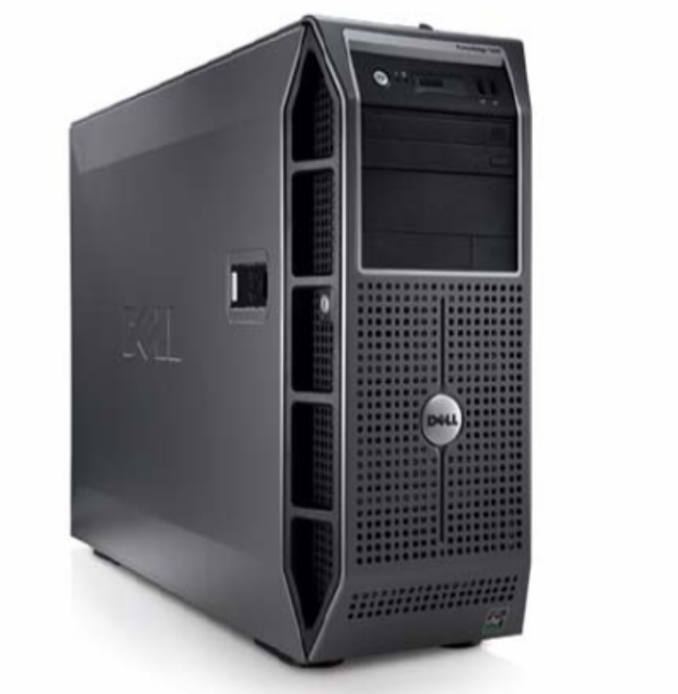
Server Hardware - Tower
Dell PowerEdge T300

Slide 9
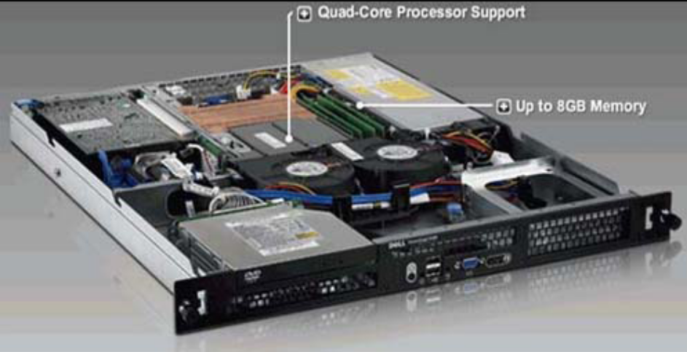
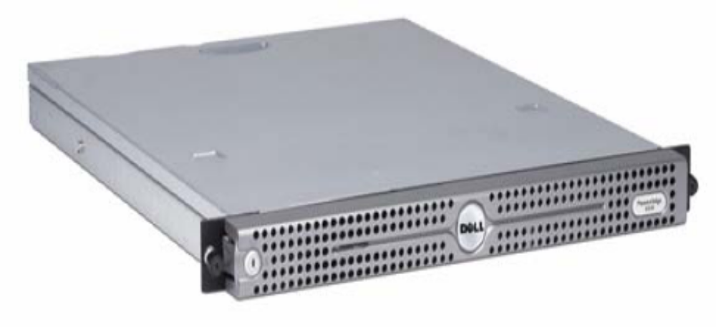
Server Hardware – Rack Mount
Dell PowerEdge R200

Slide 10
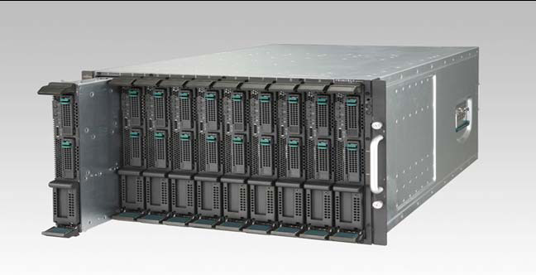
Server Hardware – Blade
HP Blade Server

Slide 11
Server Hardware - Features
Generally more capable than desktops and laptops
More RAM, storage space
Powerful processor(s), multiple processors
RAID
Hot swappable components

Slide 12
Server Hardware - Features
More connectivity – multiple ethernet / fibre ports
Redundant power supply
Robust casing
Remote monitoring

Slide 13
Server Hardware - Features
Native virtualization support – Cloud Computing
Can run for years without rebooting
Better support & warranty
Main worldwide vendors: IBM, HP, Dell
Expensive: Kshs. 100,000/- upwards

Slide 14
Server Hardware - Location
Usually stored in special server rooms, within business premises or colocation facilities
Features of server rooms and colocation centres:
  Secure
  Temperature controlled
  Cabinets
  Redundant Power
  Public IPs (world viewable)

Slide 15
Server Hardware - Location
Features of server rooms and colocation centres (continued):Spike and Surge protection
  High bandwidth availability - redundant
  Monitoring – cameras, sensors
  Fire proof, Earthquake proof
  Qualified staff
Local examples: Access Kenya, UUNET, KDN

Slide 16
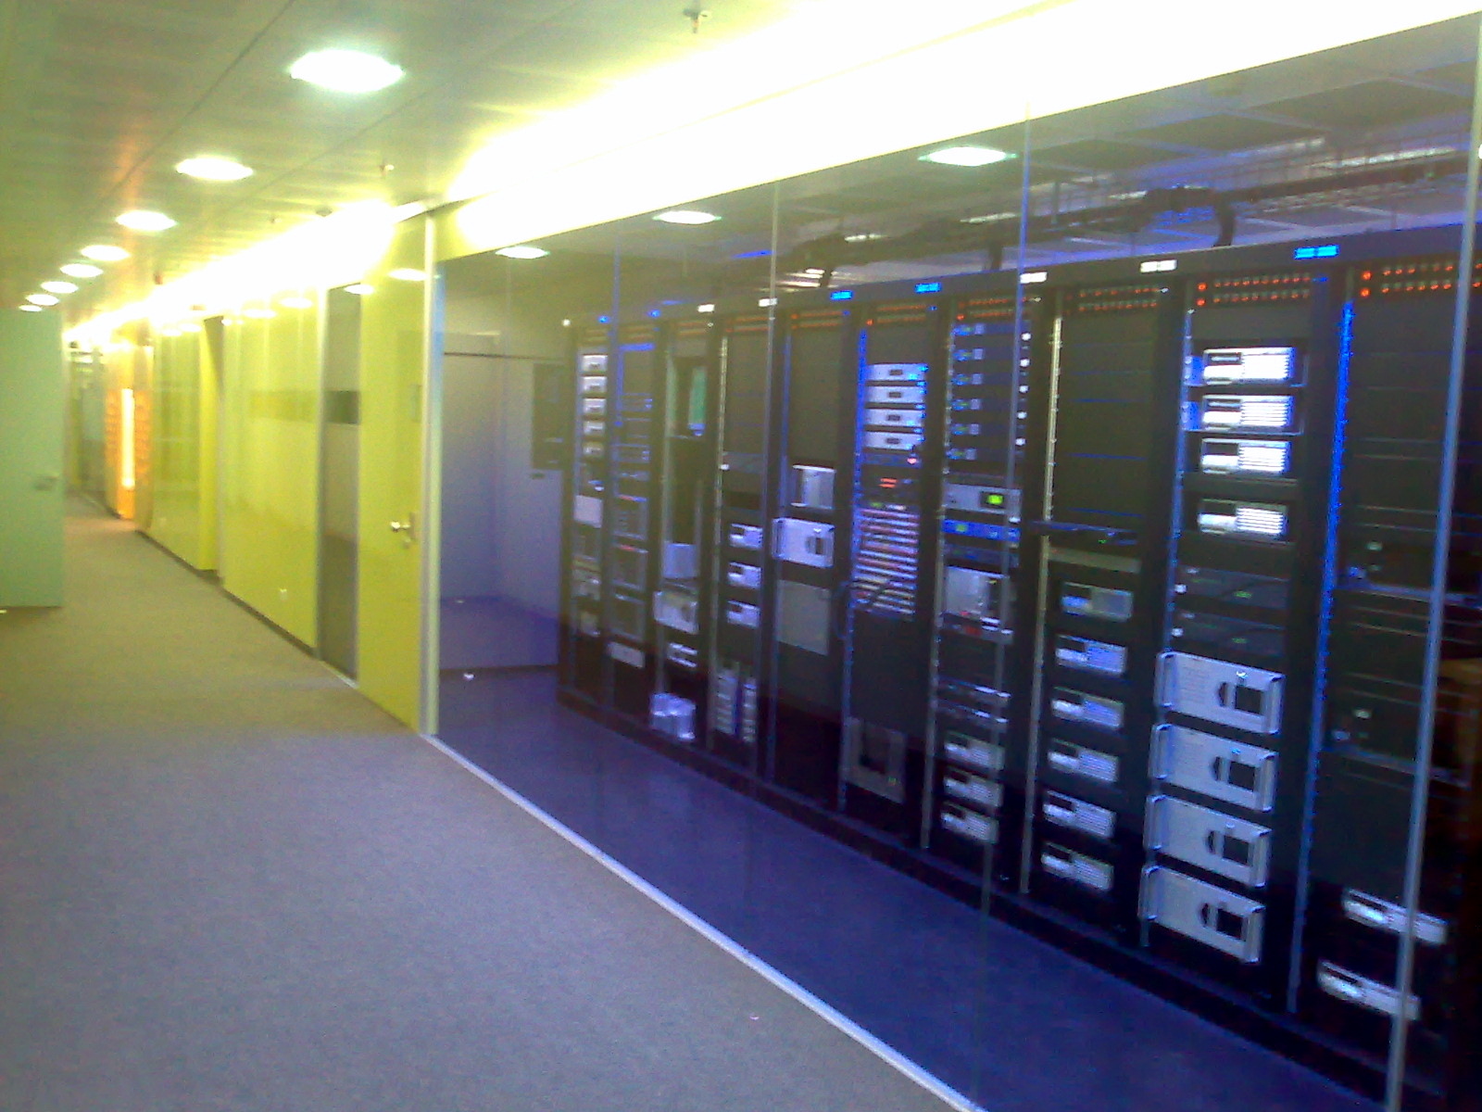
Server Hardware - Location

Slide 17
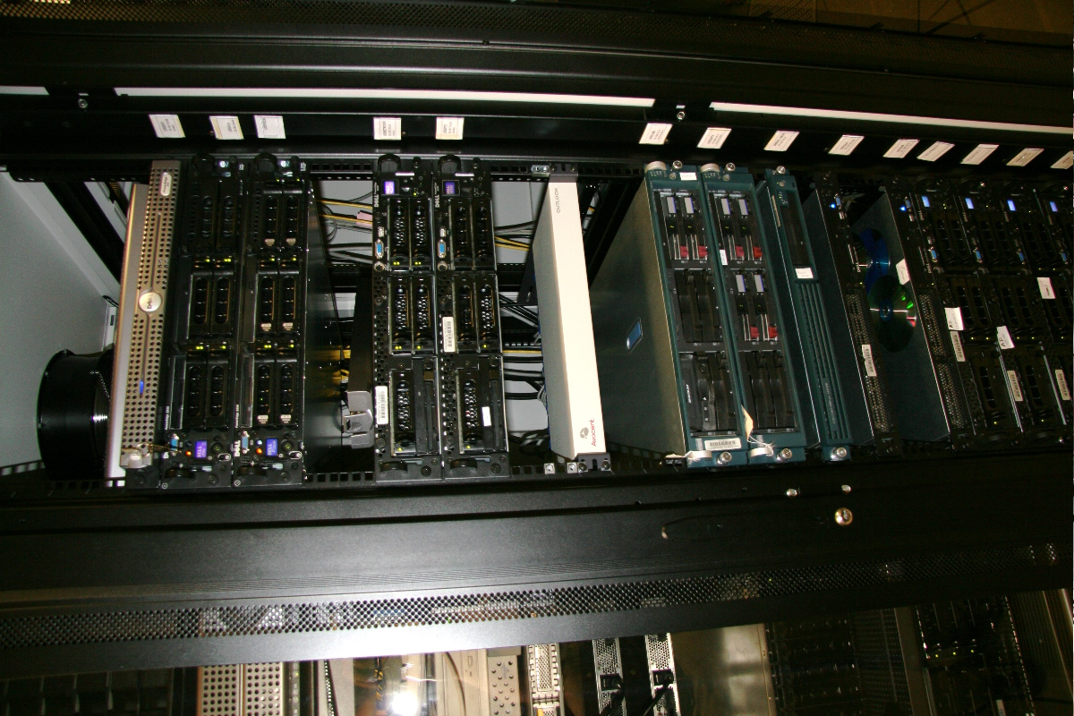
Server Hardware - Location

Slide 18
Server Software – Operating Systems
Control hardware, provide abstraction for software
2 main categories: Windows based and Unix derivatives
Windows: based on Windows NT; Windows Server 2000, 2003, 2008
Each version has different flavours, e.g. small business, standard, enterprise, data centre

Slide 19
Server Software – Operating Systems
Unix based: old Unix (AT&T, Bell Labs), BSD, Solaris, Linux
Windows servers more prevalent because of easy-to-use Graphical User Interface

Slide 20
Server Software – Operating Systems
Features of Server Operating Systems
  Robust – even during HW failure
  Multiple security features including firewalls & intrusion detection
  Remote administration
  Extensive audit trail – both people & software
  Tight coupling with hardware

Slide 21
Server Software – Operating Systems
Features of Server Operating Systems
    Generally more capable on operating system features e.g. threading (concurrency)
    handle more varied and larger file systems
    handle more RAM & virtual memory
    Support for many hardware platforms
    better performance

Slide 22
Server Software - Application
Application layer is what “talks” directly to mobile applications
Traffic can be circuit switched e.g. SMS or packet switched (Internet)
Circuit switched traffic usually converted to packet switched (Short Message Peer-to- Peer - SMPP)

Slide 23
Server Software - Application
Packet switched information is “layered”
  Mobile applications usually communicate in one of the 3 following layers:TCP / UDP
  Application e.g. HTTP, FTP
  Protocols built on application layer e.g. XML, SOAP, RMI

Slide 24
Server Software - Application
Software that services client requests: Application Server
Various application servers, can be classified by programming language
Main languages for server side programming: Microsoft .NET framework (C Sharp, J Sharp), Java & J2EE, PHP

Slide 25
Server Software - Application
.NET framework offers libraries that are tightly coupled with the operating system that can act as an application server
Java Application Servers: Tomcat, Weblogic, Websphere, Glassfish, JBoss
Main PHP application server: Apache
Other application servers in other languages

Slide 26
Server Software - Application
Server side requires persistence – SQL databases
Main vendors: Oracle, MySQL, Ingress Microsoft SQL Server, Postgres, Sybase, DB2
Some offer special features e.g. replication, clustering
Oracle is the leader

Slide 27
Server Software - Application
Special features of application servers and databases:
  Robustness
  Clustering / Load balancing
  Virtualization
  Security (code isolation, cryptography)
  Remote monitoring
  Advanced programming techniques

Slide 28
Server Software - Application
Some application servers and databases may have yet other additional features e.g. portal development, OS integration, mobile integration
Usually they come with special developer tools: programming, debugging, testing etc

Slide 29
Server Software - Application
Software models:
  Closed vs Open Source
  Proprietary vs Free

Slide 30
Server Software - Application
Server side software captures business logic
Client should be as thin as possible
Software is built in modules
Multi-tiered approach

Slide 31
Server Software - Application
Case Study: Strathmore Mobile System
Strathmore wants an SMS and Mobile Application System
Students can check grades, fees, timetables
Some of the modules: Communication, Authentication, Billing, Audit, Remote Monitoring & Administration, Backup

Slide 32
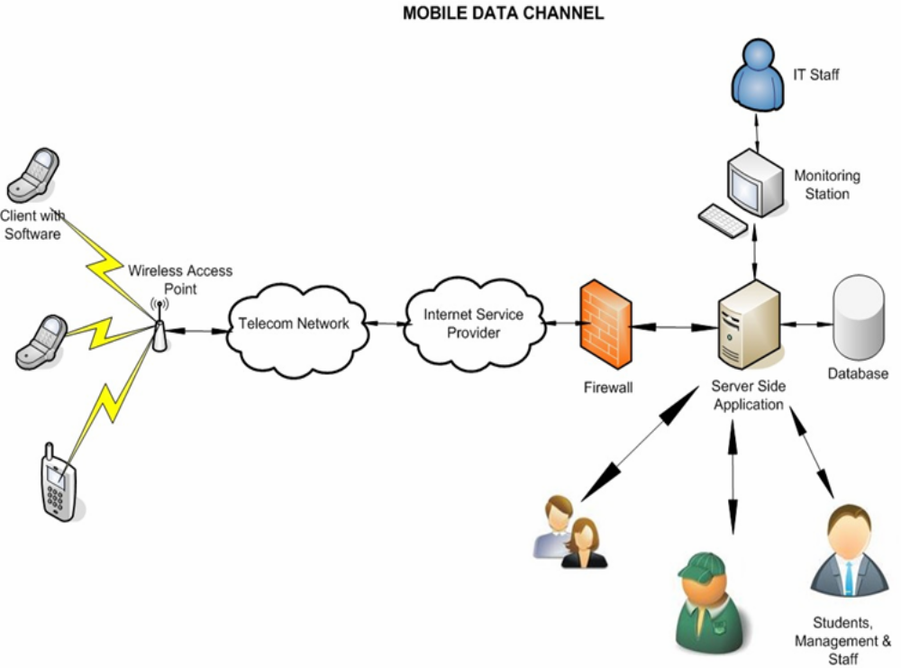
Servers - The Big Picture

Slide 33
Server Software
The End
Michael Wakahe
michael@michaelwakahe.com

